Slide 1



Outlier Detection
Key Terms
Why Multi-Variate?
DBSCAN
Isolation Forest
Local Outlier Factor
Application
Q&A

Slide 2
Key Terms
Density Based: A model that creates clusters, and compares points to the cluster
Distance Based: A model that compares points to the surrounding points (must have n samples within m distance)
Outlier Detection: Training data contains outliers, unsupervised detection
Novelty Detection: Training data contains NO outliers, supervised detection
Global Detection: Examines the dataset without regard to clusters
Local Detection: Creates clusters, and compares points in the vicinity to the cluster

Slide 3




Examples Local VS Global

Slide 4
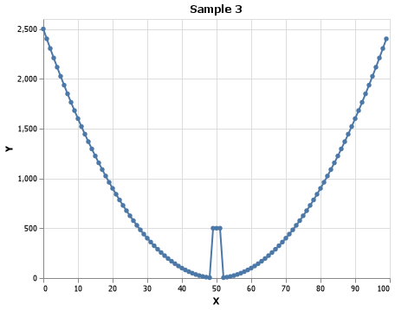
Why Multi-Variate?
Univariate: having one variable in the distribution
Normally used with STD elimination
Multivariate: Having two or more variables in the distribution
Sklearn packages

Slide 5
Interviews
Outlier detection is extremely important. You should not just cast them out, the cause of outliers should be diligently hunted down and explained whenever possible.
-Thom Ives, Lead Data Scientist at AI Stragey
Just because something is an outlier, doesn’t mean we should cast it out.
It is crucial for Data Scientists to understand outlier detection, and not just machine learning.
- Conrad Kennington, Head of ML at Vacasa

Slide 6
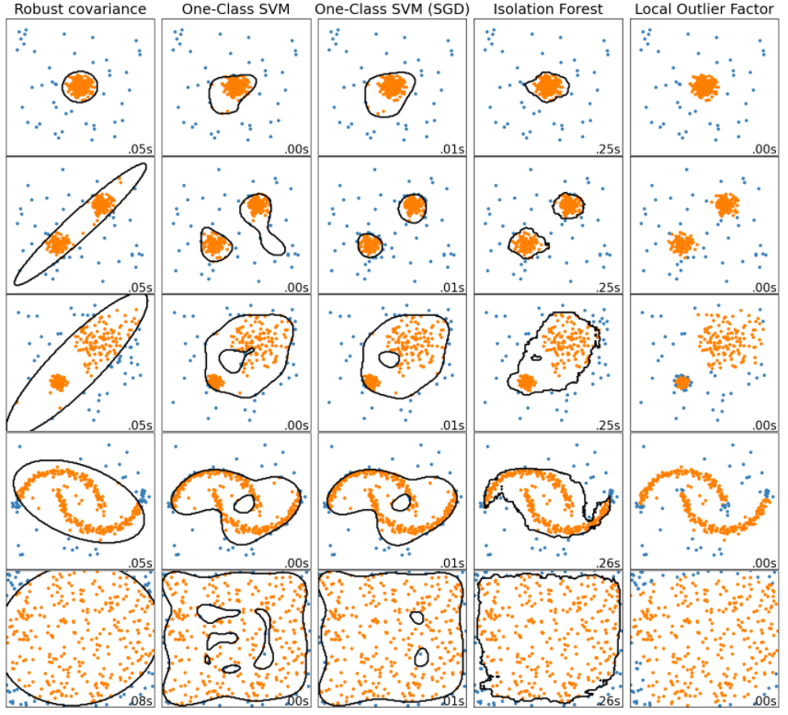

Slide 7
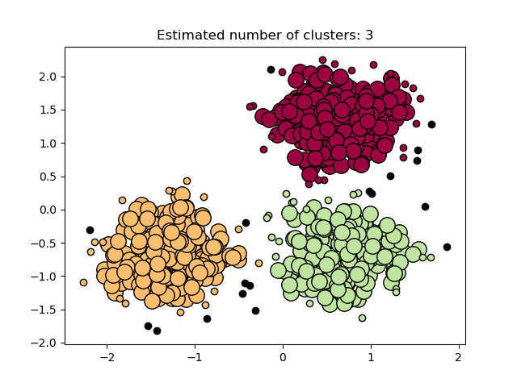
Density Based Spatial Clustering of Applications with Noise
Core Samples of high density
Creates clusters from Core Samples
2 main parameters:
Min_samples: n samples needed to create Core Samples
Eps: Distance
Metric: How distance is measured

Slide 8
DBSCAN
Core Samples of high density
Creates clusters from Core Samples
2 main parameters:
Min_samples: n samples needed to create Core Samples
Eps: Distance
Metric: How distance is measured

Slide 9
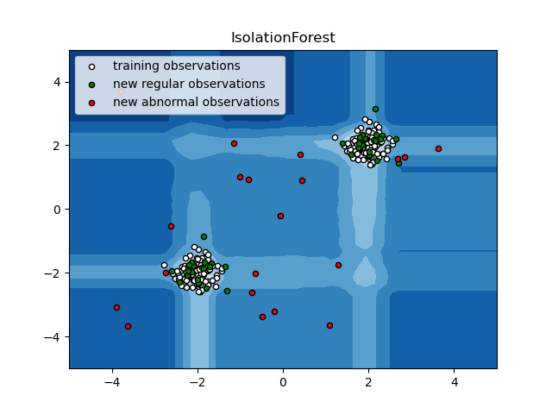
Isolation Forest
Creates partitions between min and max values
Can be represented in a ‘tree’ structure
1 main parameter:
Contamination: The ‘percent’ of contamination within the data
This will also remove x percent of rows

Slide 10
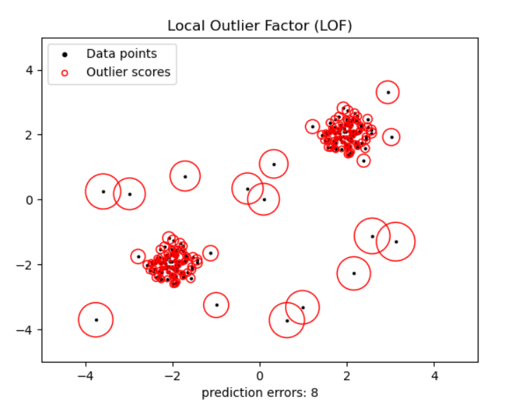
Local Outlier Factor
Focuses on Anomaly Score more than classification
Based on contamination parameter, will create a threshold
3 main parameters;
N_neighbors: number of points for a dense cluster
Metric: how distance is measured
Contamination: Percent contaminated

Slide 11
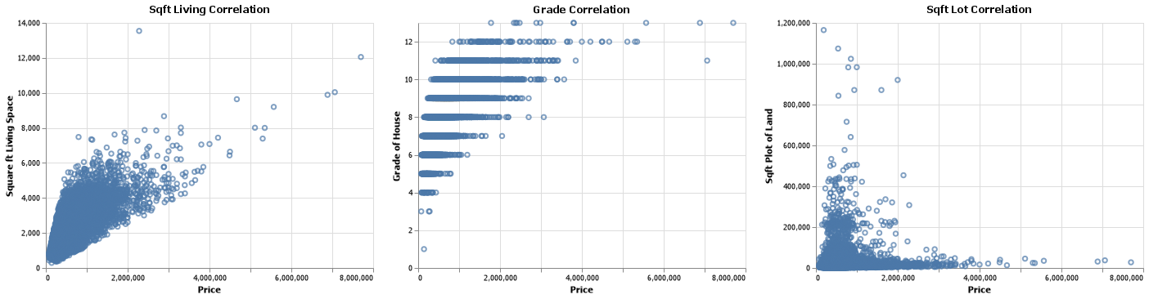
Base RMSE: $220,000
Application

Slide 12
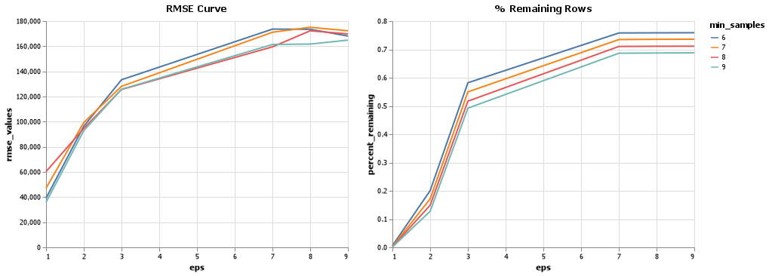
DBSCAN eps = 9 | min_samples = 6

Slide 13
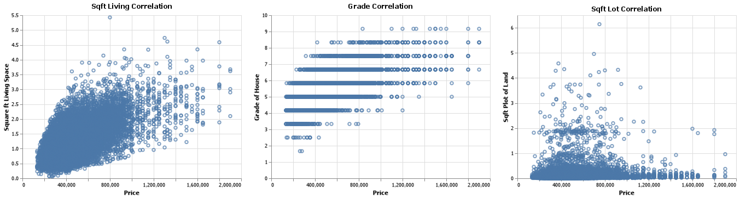
Resulting Data

Slide 14
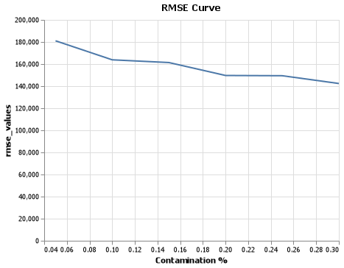
Isolation Forest contamination = .15 Decrease of $70,000

Slide 15
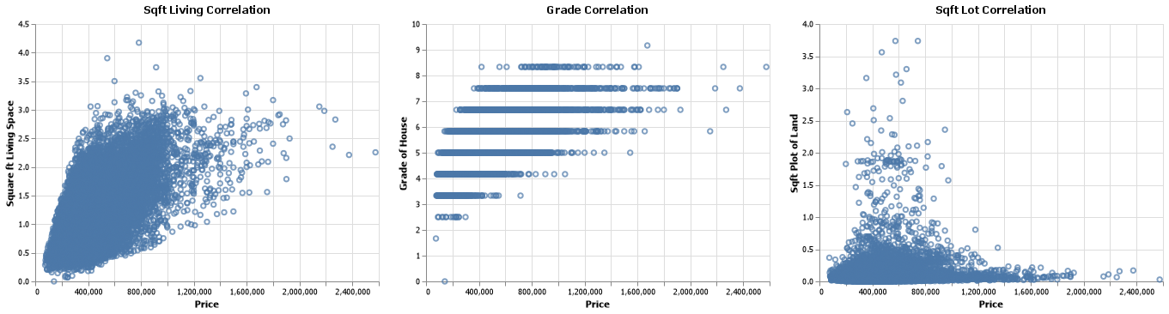
Resulting Data

Slide 16
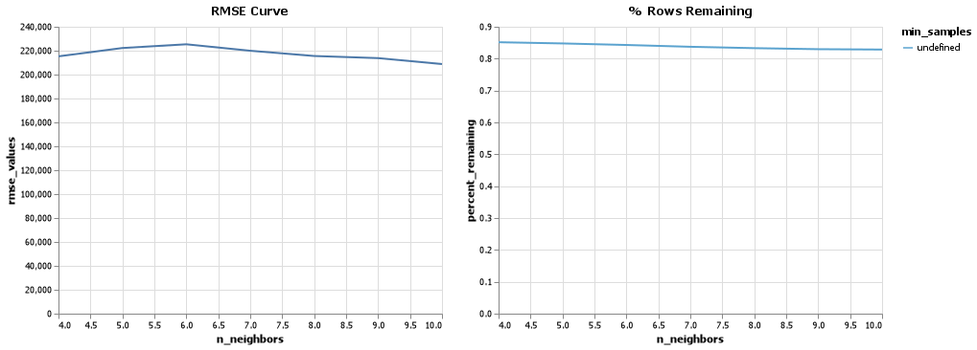
Local Outlier Factor n_neighbors = 2 | metric = ‘Euclidean’ | contamination = ‘Auto’

Slide 17
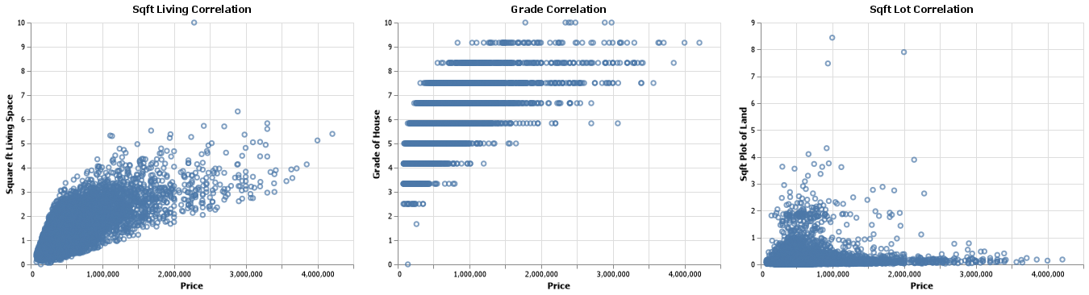
Resulting Data

Slide 18
Normal DBSCAN Isolation Forest Local Outlier Factor

Slide 19
Thank you Q&A

